Slide 1

Framing Energy, Water, and Climate Critical Links USDoE Quadrennial Energy Review Task Force Meeting San Francisco, June 19, 2014
Dr. Peter H. Gleick
www.pacinst.org

Slide 2
Overview
Water and energy
Water, energy, and climate
Integration of the “nexus” into policy
Water and security: some thoughts

Slide 3
Conclusions
Water use and energy use are closely linked.
Limits to each are beginning to affect the other; Yet energy and water issues are rarely integrated in policy.
Considering them together offers substantial economic and environmental benefits.
The reality of climate change affects policies in both areas.
There are growing risks of conflicts over water.

Slide 4
Energy systems require water
Mining/
Processing
Generation
Distribution
End Use
Water Inputs
Waste
Disposal

Slide 5

Water systems require energy
Source and
Conveyance
Treatment
Distribution
End Use
Energy Inputs
Wastewater
Treatment

Slide 6
Water constraints for energy
Drought Could Force Nuke-Plant Shutdowns
The Associated Press, January 2008
Sinking Water and Rising Tensions
EnergyBiz Insider, December 2007
Stricter Standards Apply to Coal Plant, Judge Rules; Cooling Towers for Oak Creek
Milwaukee Journal Sentinel, November 2007
Journal-Constitution Opposes Coal-Based Plant, Citing Water Shortage
The Atlanta Journal-Constitution, October 2007
Maryland County denies cooling water to proposed power plant
E-Water News Weekly, October 2007
Water woes loom as thirsty generators face climate change. Greenwire, September 2007

Slide 7
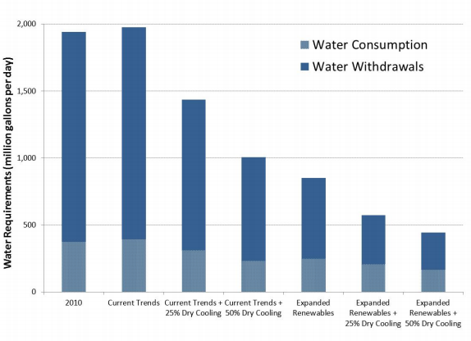
Water demands for energy systems depend on choices we make
Cooley et al. 2011. “Future water needs for electricity in the Intermountain West.” Pacific Institute, Oakland, California.

Slide 8
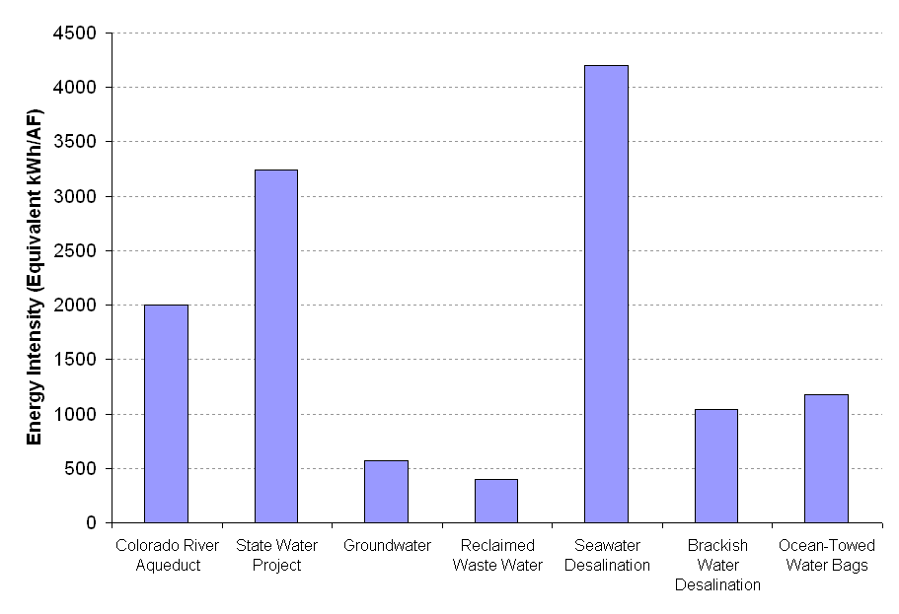
Water-supply energy intensities (Southern California)

Slide 9
The climate link
All of these water-energy links also have a climate change link, through the emission of greenhouse gases.
Some climate change – perhaps significant climate change – is already unavoidable.
We must move to avoid those consequences we cannot manage; and learn to manage those impacts we cannot avoid.

Slide 10
Policy implications
Water and energy are tightly linked, but these links are poorly understood and rarely used in policy.
Decision makers and corporations should better integrate energy issues into water policy AND water issues into energy policy.
Failure to link these issues will inevitably lead to disruptions in the supply of both water and power.

Slide 11
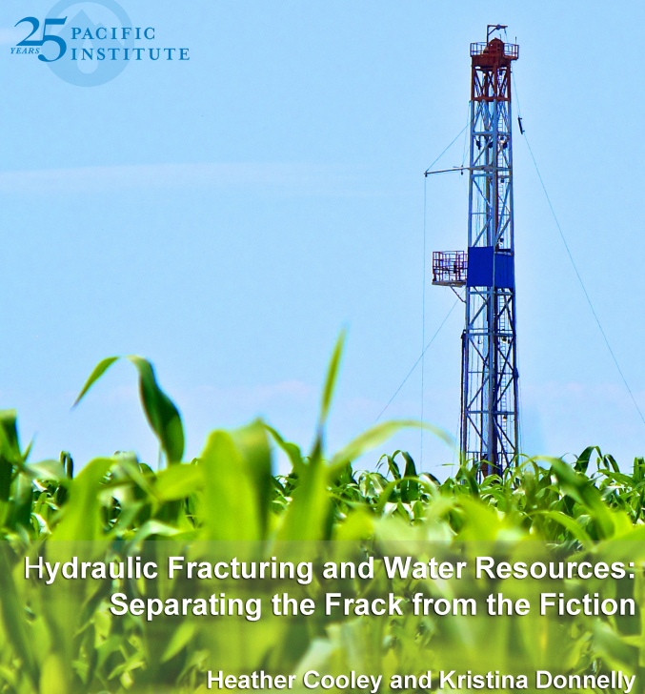
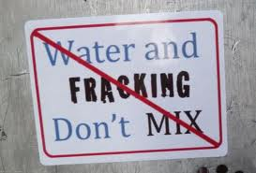

The science/hydrology of fracking is uncertain; data are scarce or proprietary. But the debate is about far more than science…
Sources: Pacific Institute 2012; Celsias; upthejones.com

Slide 12
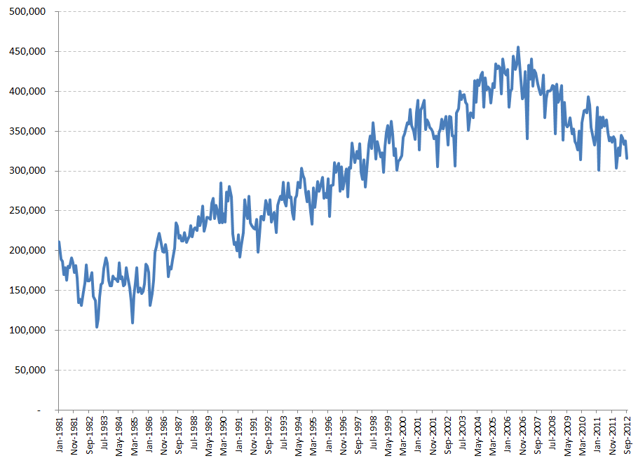
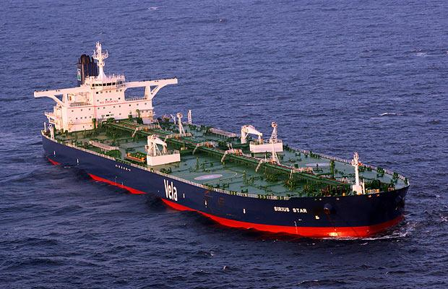
U.S. Imports of Crude Oil and Petroleum Products (thousand barrels/month)
Fracking and international security
USEIA. 2012. http://www.eia.gov/dnav/pet/hist/LeafHandler.ashx?n=PET&s=MTTIMUS1&f=M

Slide 13
“Peak Water,” security, and conflict
Definitions of “security” vary, and are expanding.
There is a long history of conflicts over fresh water.
Such conflicts take many forms (as a goal, weapon, target, development disputes, terrorism).
The risks of water-related disputes are growing, including over “peak water” constraints of all kinds.
These water-related factors will have both direct and indirect impacts on security and conflict.

Slide 14
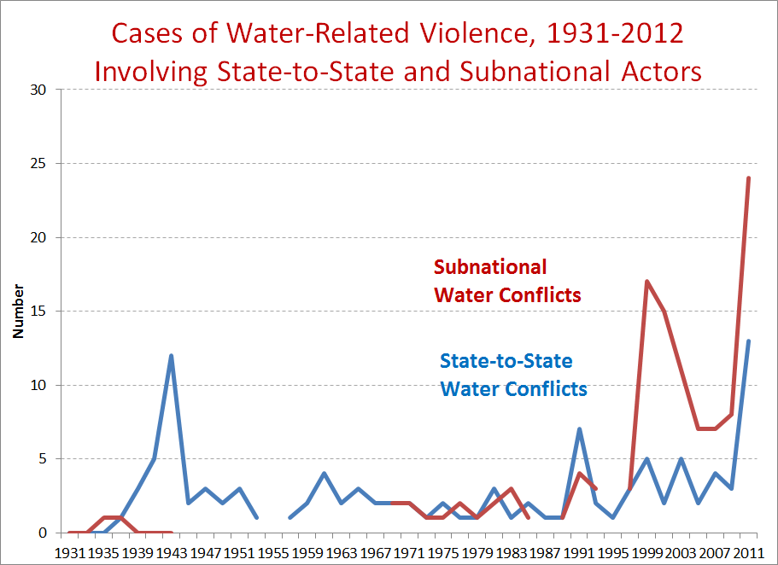
Source: Gleick 2013, Water Conflict Chronology

Slide 15
Summary and recommendations
There are strong and growing links between water, energy, climate, and security.
We rarely consider integrated policies to address these links.
The failure to address them will lead to inappropriate actions and unnecessary risks.
Smart policies can be efficient and effective.

Slide 16
Summary and recommendations
Energy choices must now consider water availability.
Water-efficiency efforts offer substantial water (and energy) savings at lower cost, and faster, than new “supply.”
Water and energy strategies can both lead to fast, cost-effective greenhouse-gas emissions reductions.

Slide 17

Dr. Peter H. Gleick
pgleick@pacinst.org
Oakland, California
www.pacinst.org
www.worldwater.org

